Slide 1
DIFFERENTIAL SCANNING CALORIMETRY (DSC)

Slide 2
CONTENTS:
Principle
Thermal transitions
Advantages,
Disadvantages
Instrumentation
Applications and interpretations

Slide 3
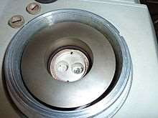
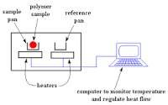
Introduction
Differential Scanning Calorimetry, or DSC, is a thermoanalytical technique in which the difference in the amount of heat required to increase the temperature of a sample and reference is measured as a function of temperature.
The technique was developed by E. S. Watson and M. J. O'Neill in 1962, and introduced commercially at the 1963 Pittsburgh Conference on Analytical Chemistry and Applied Spectroscopy.
The first adiabatic differential scanning calorimeter that could be used in biochemistry was developed by P. L. Privalov and D. R. Monaselidze in 1964 at Institute of Physics in Tbilisi, Georgia.

Slide 4
ADVANATGES :
Rapidity of Determination
Versatile and simple
Ease and speed with which it can be used to see transitions in materials
It allows a cost-effective determination of certain relevant thermal properties of materials with a moderate effort
Limitations:
Interpretation of result is difficult
Significant differences can arise between DSC results for the same material when they measured in different laboratories.

Slide 5
Principles of DSC
The Sample and Reference are maintained at the same temperature, even during a thermal event in the sample.
The energy required to maintain zero temperature difference between the sample and the reference is measured.
During a thermal event in the sample, the system will transfer heat to or from the sample pan to maintain the same temperature in reference and sample pans.
DSC is a technique in which the difference in the amount of heat required to heat the temperature of a sample and reference are measured as function of temperature.
Both the sample and reference are maintained at nearly the same
temperature throughout the experiment.
A Differential Calorimeter measures the heats the sample relative to a reference.

Slide 6
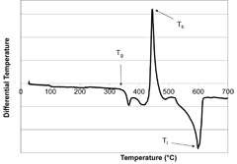
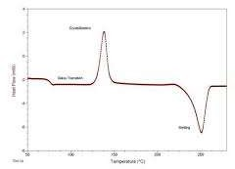
Comparison Of DTA & DSC
1. “DSC” stands for “Differential Scanning Calorimetry”. | 1. “DTA” stands for “Differential Thermal Analysis.”
2. DSC is a technique in which the difference is calculated between the amount of heat needed (heat flow) to increase the temperature of the sample and the heat required to increase the temperature of the reference. | 2. DTA is a technique in which the difference is calculated between the temperatures required by the reference and the sample when the heat flow is kept the same for both.
3. DSC is an instrument based on the DSC technique used to measure heat released or absorbed during the transition phase. | 3. DTA is an instrument based on the DTA technique to measure temperature difference.

Slide 7
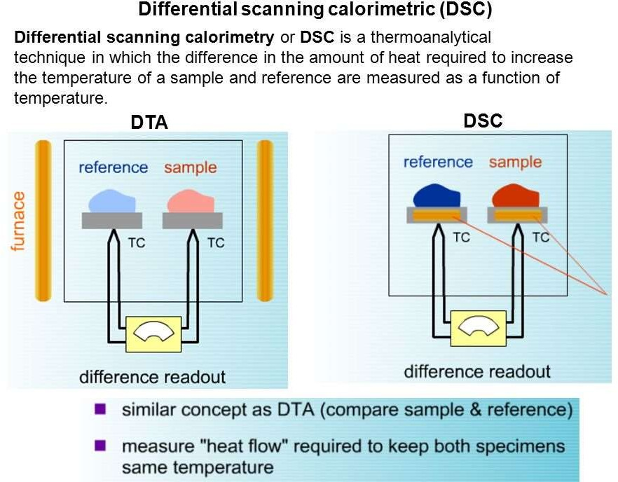
Comparison Of DTA & DSC

Slide 8
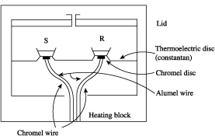
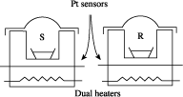
Instrumentation Of DSC
Two basic types of DSC instruments
1. Heat-Flux DSC and
2. Power Compensation DSC
Power compensation DSC
Heat flux DSC

Slide 9

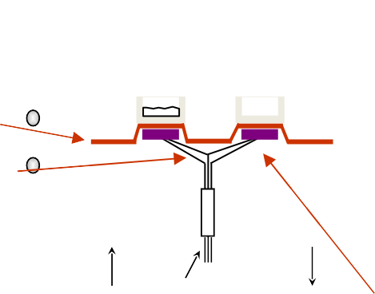
1. Heat Flux DSC
heating coil
sample pan
reference pan
constantan
chromel/alumel wires
Sample and reference holders
Al or Pt pans placed on constantan disc
Sample and reference holders are connected by a low-resistance heat flow path
Sensors
Chromel® (an alloy made of 90% nickel and 10% chromium) - constantan area thermocouples (differential heat flow)
Chromel® - alumel (an alloy consisting of approximately 95% nickel, 2% manganese, 2% aluminium and 1% silicon) thermocouples (sample temperature)
Thermocouple is a junction between two different metals that produces a voltage due to a temperature difference
inert gas vacuum
thermocouples
Chromel

Slide 10
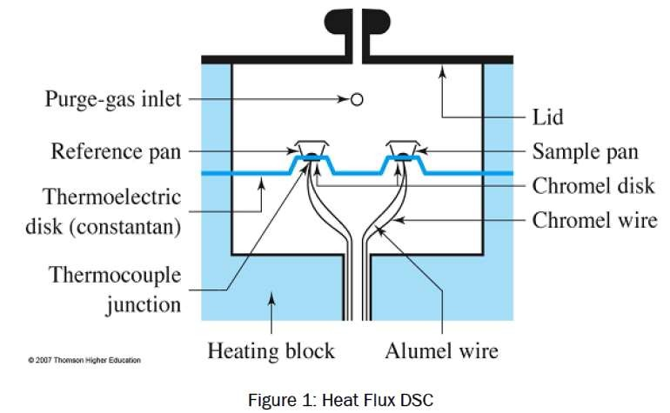
Furnace
One block for both sample and reference cells
Temperature controller
The temperature difference between the sample and reference is converted to differential thermal power, which is supplied to the heaters to maintain the temperature of the sample and reference at the program value.

Slide 11
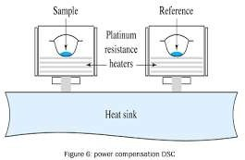
2. Power Compensation DSC:
Sample Holder:
Aluminum or Platinum Pans.
Sensors:
Platinum resistance thermocouples
Separate sensors and heaters for the sample and reference.
Furnace:
Separate blocks for sample and reference cells.
Temperature controller:
Supply the differential thermal power to the heaters to maintain the temperature of the sample and reference at the program value.

Slide 12
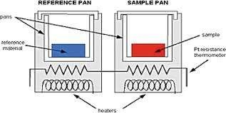
The main application of DSC is in studying phase transitions, such as melting, glass transitions, or exothermic decompositions.
These transitions involve energy changes or heat capacity changes that can be detected by DSC with great sensitivity.

Slide 13
Temperature
Goal is to match the melting onset temperatures indicated by the furnace Thermocouple readouts to the known melting points of standards analyzed by DSC
Should be calibrated as close as possible to the desired temperature range
Heat flow
Use of calibration standards of known heat capacity, such as sapphire, slow accurate heating rates (0.5–2.0°C/min), and similar sample and reference pan weights

Slide 14
Calibrants
Metals
Indium
Stannous
Aluminum Inorganics
KNO₃
KClO₄ Organics
Polystyrene
Benzoic acid
Anthracene
High purity
Accurately known enthalpies
Thermally stable
Light stable (hʋ)
Non-hygroscopic
Un-reactive (pan, atmosphere)

Slide 15
Sample Preparation
Accurately-weigh samples (~3-20 mg)
Small sample pans (0.1 mL) of inert or treated metals (Al, Pt, Ni, etc.)
Several pan configurations, e.g., open, pinhole, or hermetically-sealed (airtight) pans
The same material and configuration should be used for the sample and the reference
Material should completely cover the bottom of the pan to ensure good thermal contact

Slide 16


Avoid overfilling the pan to minimize thermal lag from the bulk of the material to the sensor
* Small sample masses and low heating rates increase resolution
Al
Pt
alumina
Ni
Cu
quartz

Slide 17

Nature of DSC Curves
The result of a DSC experiment is a curve of heat flux versus temperature or versus time. There are two different conventions: exothermic reactions in the sample shown with a positive or negative peak, depending on the kind of technology used in the experiment.
This curve can be used to calculate enthalpies of transitions, which is done by integrating the peak corresponding to a given transition. The enthalpy of transition can be expressed using equation:
ΔH = KA
Where ΔH is the enthalpy of transition
K is the calorimetric constant,
A is the area under the peak
The calorimetric constant varies from instrument to instrument, and can be determined by analyzing a well-characterized material of known enthalpies of transition.
Area under the peak is directly proportional to heat absorbed or evolved by the
reaction,
Height of the peak is directly proportional to rate of the reaction.

Slide 18
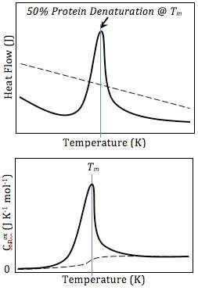
A schematic DSC curve of amount of energy input (y) required to maintain each temperature (x), scanned across a range of temperatures. Bottom: Normalized curves setting the initial heat capacity as the reference. Buffer-buffer baseline (dashed) and protein-buffer variance (solid).

Slide 19

Factors Affecting Curves
Two types of factors effect the DSC curve: 1.Instrumental factors:
Furnace heating rate.
Recording or chart speed.
Furnace atmosphere.
Geometry of sample holder/location of sensors.
Sensitivity of the recoding system.
Composition of sample containers.
2. Sample Characteristics:
Amount of sample
Nature of sample
Sample packing

Slide 20
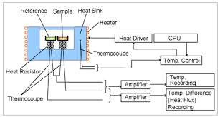
Solubility of evolved gases in the sample.
Particle size.
Heat of reaction.
Thermal conductivity.
BLOCK DIAGRAM

Slide 21
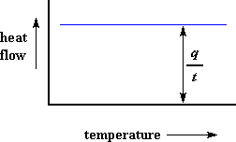
Determination of Heat Capacity
DSC plot can be used to determine Heat Capacity.
Suppose a polymer is being heated.
When we start heating two pans, the computer will plot the difference in heat output of the two heaters against temperature that is plot of heat absorbed by the polymer against temperature.
The plot will look like this at first.

Slide 22
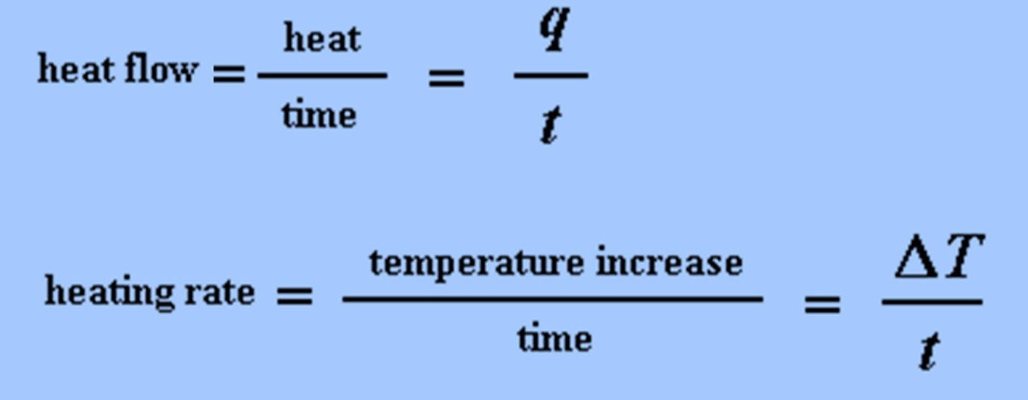
The heat flow is heat (q) supplied per unit time (t), whereas,
The heating rate is temperature increase (ΔT) per unit time (t)

Slide 23
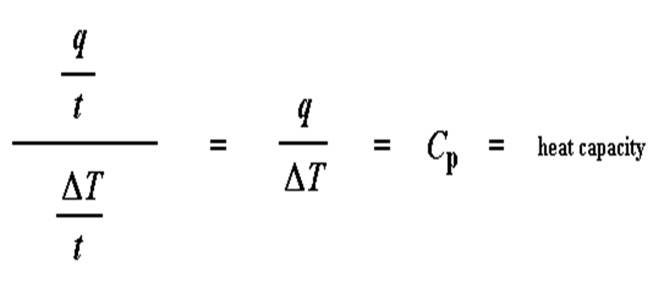
By dividing heat flow (q/t) by the heating rate (ΔT/t). It ends up with heat supplied divided by the temperature increase, which is called heat capacity.

Slide 24
When a certain
amount the
of heat is
its
transferred to temperature increases
sample,
by a certain
amount, and the amount of heat it takes to get a certain temperature increase is called the heat capacity, or C_{p}, it can be
figured up from the DSC plot

Slide 25
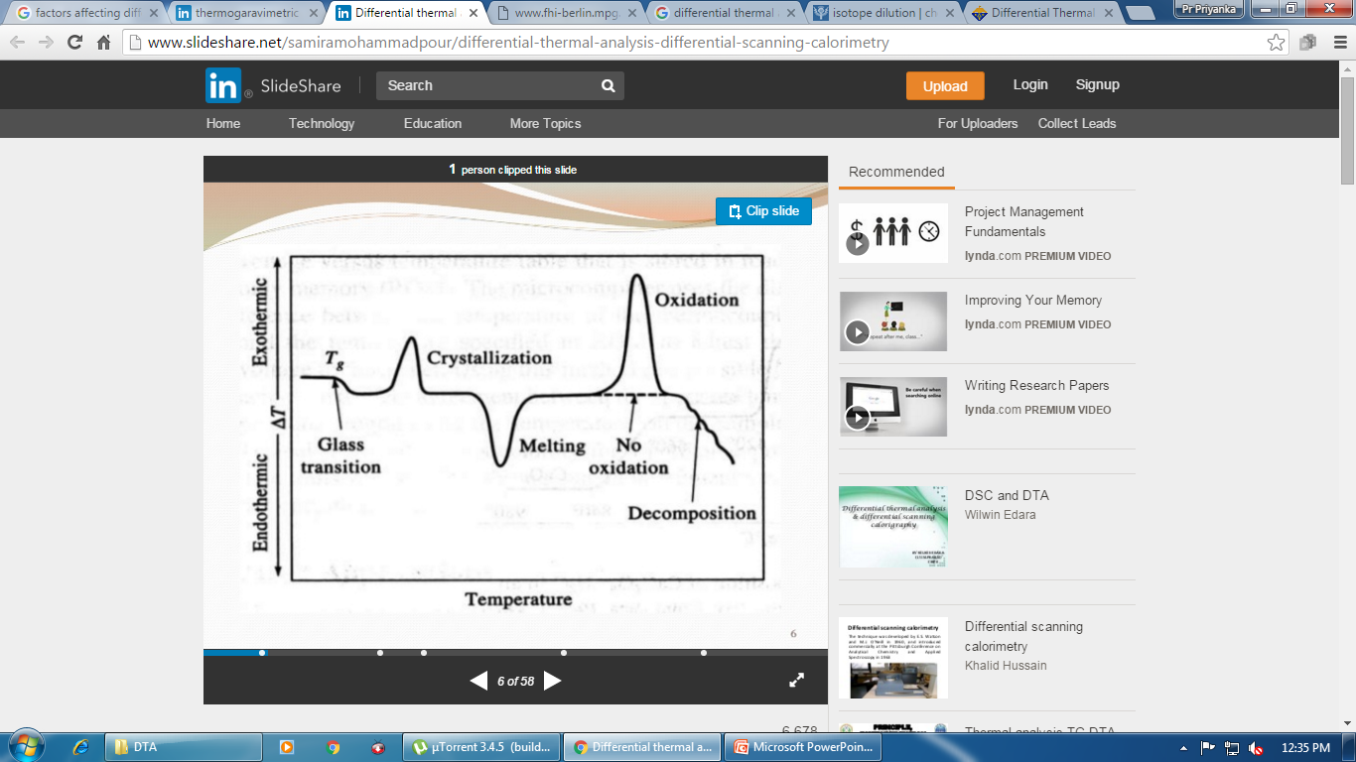
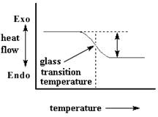
The Glass Transition Temperature
On further heating the polymer to a certain temperature, plot will shift downward suddenly, like this:

Slide 26
This means there is more heat flow. There is an increase in the heat capacity of the polymer.
This happens because the polymer has just gone through the glass transition.
Because of this change in heat capacity that occurs at the glass transition, we can use DSC to measure a polymer's glass transition temperature.
Take note that this change doesn't occur suddenly, but takes place over a temperature range.
This makes picking one discreet Tg a kind of tricky matter, but we usually just take the middle of the incline to be the Tg.

Slide 27
Crystallization
After glass transition, the polymers have a lot of mobility.
They wiggle and squirm, and never stay in one position for very long time.
But when they reach the right temperature, they will give off enough energy to move into very ordered arrangements, which is called crystals.

Slide 28
When polymers fall into these crystalline arrangements, they give off heat.
When this heat is dumped out, it makes the little computer-controlled heater under the sample pan really happy.
It's happy because it doesn't have to put out much heat to keep the temperature of the sample pan rising.
You can see this drop in the heat flow as a big peak in the plot of heat flow versus temperature.

Slide 29
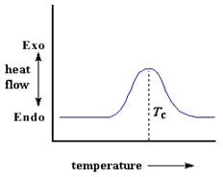
The temperature at the highest point in the peak is usually considered to be the polymer's crystallization temperature, or T_{c}

Slide 30
Also, we can measure the area of the peak, which tells us the latent energy of crystallization of the polymer
But most importantly, this peak tells us that the polymer can in fact crystallize
If you analyze a 100% amorphous polymer, like polystrene, you wouldn't get this peak, because such materials don't crystallize
Also, because the polymer gives off heat when it crystallizes, we call crystallization is an exothermic transition.

Slide 31
Melting
When the heating continues the heat is absorbed and this transition, called melting.
When we reach the polymer's melting temperature, T_{m}, polymer crystals begin to fall apart, that is they melt.
It comes out of their ordered arrangements, and begin to move around freely that can be spotted on a DSC plot

Slide 32
Remember, the heat which polymer give off when crystallized is absorbed when reached at T_{m}.
That is a latent heat of melting like latent heat of crystallization.
When the polymer crystals melt, they must absorb heat in order to do so.
Remember melting is a first order transition.
This means that at the melting temperature, the polymer's temperature won't rise until all the crystals have melted.

Slide 33
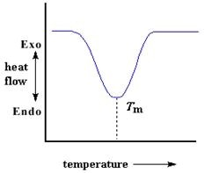
This means that the little heater under the sample pan has to put a lot of heat into the polymer in order to both melt the crystals and keep the temperature rising at the same rate as that of the reference pan. This extra heat flow during melting shows up as a big dip on DSC plot, like this:

Slide 34
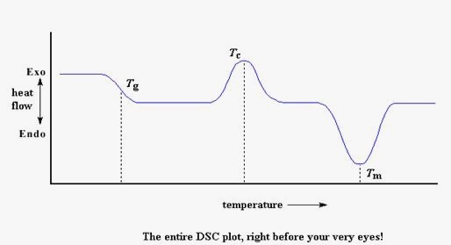
Putting It All Together
•
we saw a step in the plot when the polymer was heated past its glass transition temperature. Then we saw a big peak when the polymer reached its crystallization temperature.
Then finally we saw a big dip when the polymer reached its melting temperature. To put them all together, a whole plot will often look something like this:

Slide 35
Of course, not everything you see here will be on every DSC plot. The crystallization peak and the melting dip will only show up for polymers that can form crystals and melts.
Completely amorphous polymers won't show any crystallization, or any melting either. But polymers with both crystalline and amorphous domains, will show all the features

Slide 36
From DSC plot you can see a big difference between the glass transition and the other two thermal transitions, crystallization and melting.
For the glass transition, there is no dip, and there's no peak, either.
This is because there is no latent heat given off, or absorbed, by the polymer during the glass transition.
Both melting and crystallization involve giving off or absorbing heat.

Slide 37
The only thing we do see at the glass transition temperature is a change in the heat capacity of the polymer.
Because there is a change in heat capacity, but there is no latent heat involved with the glass transition, we call the glass transition a second order transition.
Transitions like melting and crystallization, which do have latent heats, are called first order transitions

Slide 38

References & Sources
Molecular biology (in Russian). 6. Moscow. 1975. pp. 7–33.
Wunderlich, B. (1990). Thermal Analysis. New York: Academic Press. pp. 137–140.
Dean, John A. (1995). The Analytical Chemistry Handbook. New York: McGraw Hill, Inc. pp. 15.1–15.5
B. Wunderlich, Macromolecular Physics, (1980), Vol. 3, Ch. 8, Table VIII.6.
Brydson, J. A., Plastics Materials, Butterworth-Heinemann, 7th Ed (1999).
Ezrin, Meyer, Plastics Failure Guide: Cause and Prevention, Hanser-
SPE (1996).
Wright, D. C., Environmental Stress Cracking of Plastics RAPRA (2001).

